Slide 1
WHAT WE DID
What is a DS
What is an algorithm?
Many data structures and algorithms
Why do we need to choose the optimum/suitable DS/Algo
Real-world applications of DS and Algorithms

Slide 2
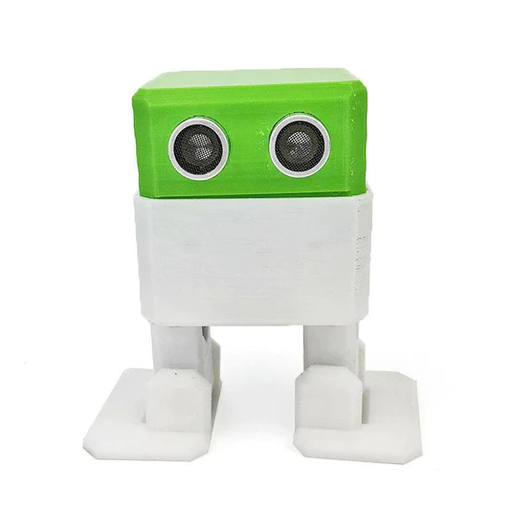
ACTIVITY: OTTO THE ROBOT

Slide 3
Stack
Data Structure

Slide 4
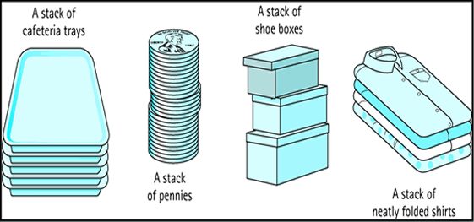
Stacks

Slide 5
Stack Data Structure
As the name implies the stack, data structure also behave as any other stack in the real world.
Stack allow you to access one data item.
That is the last data item inserted.
If you remove this item then you will be able to access to next-to last element.

Slide 6
Stacks
Insert an data item : PUSH
Delete an data item: POP
Reading Top value at the Stack: PEEK
Check for Empty Stack/ Full stack : IsEmpty/ IsFull
E.g. Stack of Plates
Stack of letters
LIFO

Slide 7
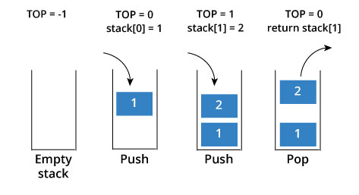
Graphical Representation

Slide 8
Creating a new Stack
The stack implementation is based on an array.
But stack restrict accesses.
We have created ‘stack’ structure.
We have array of elements having size ‘size’
To keep track of Topmost element we have declared top as structure member

Slide 9
Creating a new Stack
#define size 5
/* stack structure*/
struct stack {
int s[size];
int top;
}st;

Slide 10
Inserting an Element: Push
void push(int item)
{
st.top++;
st.s[st.top] =item;
}
Added to the top of the stack.

Slide 11
Removing an Element: Pop
int pop()
{
int item;
item = st.s[st.top];
st.top--;
return (item);
}
Remove the top item from the stack

Slide 12
Check for Empty/Full stack
int stempty()
{
if(st.top==-1)
return 1;
else
return 0;
}
int stfull()
{
if(st.top>=size-1)
return 1;
else
return 0;
}

Slide 13
Efficiency of the Stack:
Remove the top (Pop) item from the stack/ insert item to the top of the stack (Push)
O(1)
No comparisons needed ☺

Slide 14
#include<stdio.h>
struct myStack{
int myarray[5];
int top=-1; //error 1
}st;
void push(){ //error 2
st.top++;
st.myarray[top]=ele; //error 3
printf("Item Added to index %d\n", st.top);
}
int pop(int ele){ //error 4
int out=myarray[st.top]; //error 5 printf("popped out item at index %d", st.top); //error 6
}
int main(){ //error 7 push(10); push(20); push(30); pop();
return 0;
}

Slide 15
#include<stdio.h>
struct myStack{
int myarray[5];
int top;
}st;
void push(int ele){
st.top++;
st.myarray[st.top]=ele;
printf("Item Added to index %d\n", st.top);
}
int pop(){
int out=st.myarray[st.top];
printf("popped out item at index %d", st.top);
return out;
}
int main(){
st.top=-1;
push(10); push(20); push(30); pop();
return 0;
}

Slide 16
Exercise
Write a C program to implement an integer-based stack. You’re required to Perform
PUSH(insert operation)- we’ll take input from the user
POP(Delete operation) – We’ll return the popped value
Display stack- We’ll print all the values in the stack

Slide 17
Step 01:
Create a Stack data structure using Array :
/* Structure definition for stack */
struct stack {
int stk[MAXSIZE];
int top;
}s;

Slide 18
Step 02
/*Function to add an element to the stack*/
void push ()
{
int num;
if (s.top == (MAXSIZE - 1))
{
printf ("Stack is Full\n");
return;
} else
{
printf ("Enter the element to be pushed\n");
scanf ("%d", &num);
s.top = s.top + 1;
s.stk[s.top] = num;
}
return;
}

Slide 19
Step 03
/*Function to delete an element from the stack*/
int pop ()
{
int num;
if (s.top == - 1)
{
printf ("Stack is Empty\n");
return (s.top);
}
else
{
num = s.stk[s.top];
printf ("poped element is = %d\n", s.stk[s.top]);
s.top = s.top - 1;
}
return (num);
}

Slide 20
Step 04
/*Function to display the status of the stack*/
void display ()
{
int i;
if (s.top == -1)
{
printf ("Stack is empty\n");
return;
}
else
{
printf ("\nThe status of the stack is\n");
for (i = s.top; i >= 0; i--) {
printf ("%d\n", s.stk[i]);}
}
}
}

Slide 21
Thank You

